Slide 1
A Closer Look at
Women’s Careers in Physics: Results from the Global Survey of Physicists
Rachel Ivie and Casey Langer Tesfaye
Funded by
Henry Luce Foundation
National Science Foundation, Award 1012148
Beverly Hartline, Principal Investigator

Slide 2
Why survey women in physics?

Slide 3
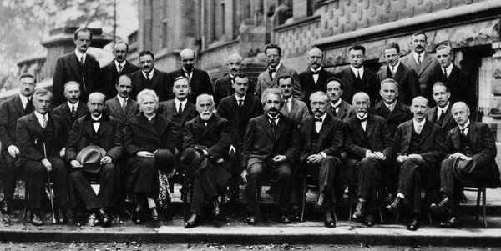
At the Solvay Conference on Physics in 1927, the only woman in attendance was Marie Curie (bottom row, third from left).
Source: http://ontd-political.livejournal.com/10806258.html#ixzz30UyWOvOz
Notes:
Very active time- many high profile articles, many citing survey data

Slide 4
“You never see someone that looks like me as a scientist. No matter how long I stay here. When I walk through the campus, no one’s ever gonna look at me and just think that I’m a physicist . . . I guess the things that have made other people find it hard to see me as a scientist are making it hard for me to see myself as a scientist, too.” —Sofía Caldo, Chicana college senior
from “Body Projects of Young Women of Color in Physics” (2005) by Maria Ong – article based on interviews with ten young women of color about their experiences in physics departments

Slide 5
(Spain) “It is difficult when you are, as I have been, the only woman in a conference. Or when people interrupt, or do not listen or even laugh at what you are saying, even if it is important. Or when advisors or mentors could not believe that I’d done the work myself.”
Notes:
From 2nd survey

Slide 6
Although representation is very low
Documenting underrepresentation is not enough!
In this study, we use Global Survey data to focus on
  Opportunities
  Resources
  Work and family

Slide 7
Why a Global Survey of Physicists?
Goal: To describe common problems that women in physics across the world face in their work and studies
With IUPAP Women’s Working Group, AIP has done 3 global surveys

Slide 8
Goals of the Third Global Survey
Languages other than English
Comparability across countries
To examine whether women physicists’ experiences are different from men’s
Notes:
3rd survey in a series

Slide 9
How the survey was developed
Web survey developed and translated in collaboration with country leaders from the 3rd ICWIP conference in Seoul
Notes:
Sample surveys were drawn by American and German Physical Societies, so their results are representative of their membership.
Survey went to entire membership of Japanese Physical Society.

Slide 10
Languages
English
French
Russian
Arabic
Chinese
Spanish
German
Japanese
Notes:
UN plus German & Japanese

Slide 11
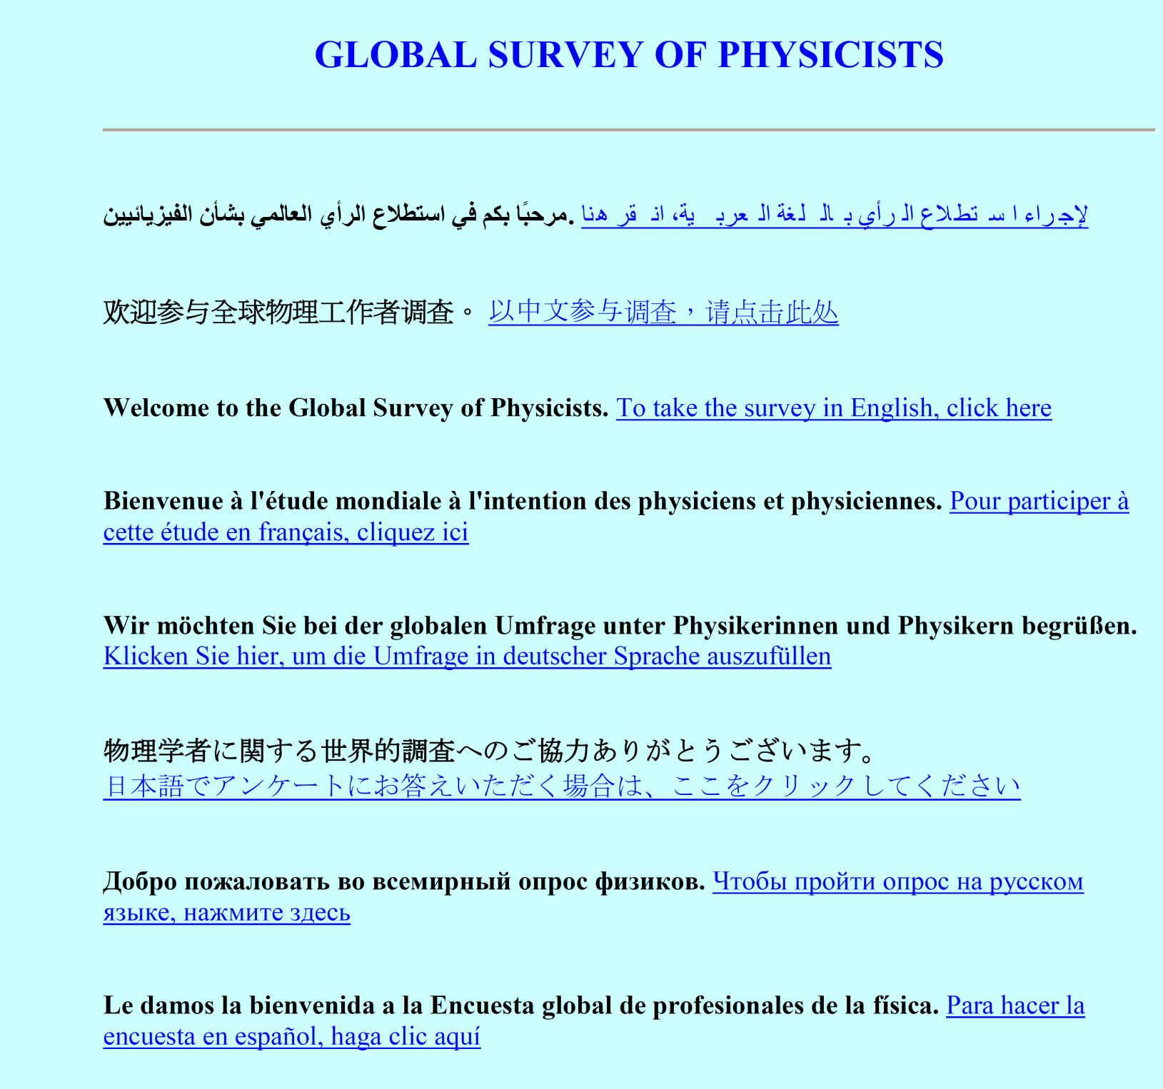
Notes:
This is the Welcome Page to the current Global Survey. It is available in 8 languages.

Slide 12
How the survey was distributed
Web survey sent to country leaders from conference
Survey itself contained instructions to forward to colleagues
Open from ~Oct. 2009-Oct. 2010
Notes:
Sample surveys were drawn by American and German Physical Societies, so their results are representative of their membership.
Survey went to entire membership of Japanese Physical Society.

Slide 13
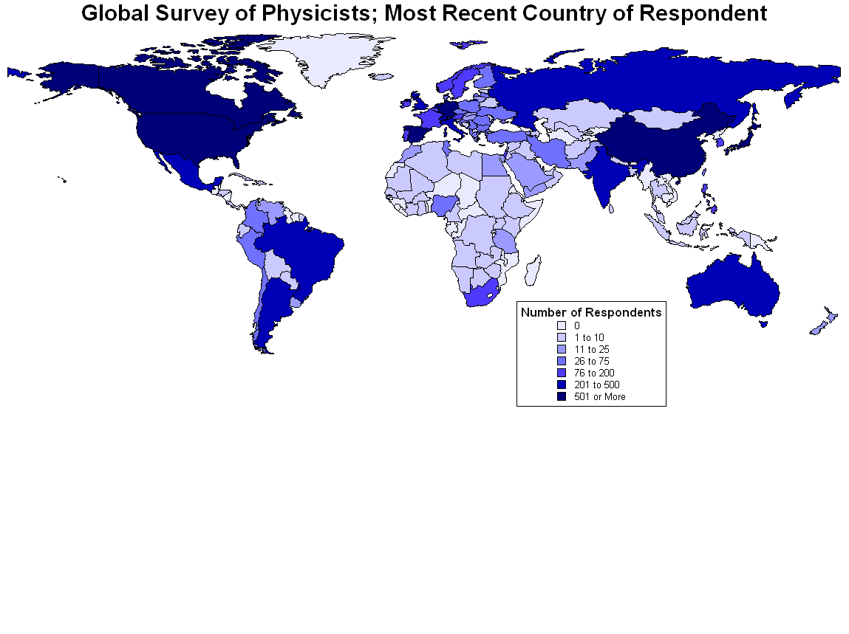

Slide 14
Who Responded?
14,932 respondents
130 countries
22% women
Employed in all types of jobs

Slide 15
Who Responded?
14,932 respondents
130 countries
22% women
Employed in all types of jobs
NOT Representative

Slide 16
Further Analysis by Region or Country
Note: The data reflect respondents only and are not representative of any nation or region.
Not appropriate to generalize across regions

Slide 17
Country Level Analysis
For analysis, nation needed at least 30 female respondents who were not students
Notes:
30 chosen as an acceptable threshold for statistical power

Slide 18
Countries Included:
Argentina
Australia
Brazil
Canada
China-Beijing
France
Germany
Italy
Japan
Spain
United Kingdom
United States

Slide 19
Resources and opportunities
Models tested

Slide 20
Opportunities (11)
Have you participated in the following? (Yes/No)
  Given a talk at a conference as an invited speaker
  Attended a conference abroad
  Conducted research abroad
  Acted as a boss or manager
  Served as editor of a journal
  Served on committees for grant agencies
  Served on important committees at your institute or company
  Served on an organizing committee for a conference in your field
  Advised undergraduate students
  Advised graduate students
  Served on thesis or dissertation committees (not as advisor)

Slide 21
Accumulation of Opportunities
Tested by regression
Model accounted for experience
  More experienced respondents have, on average, more opportunities
The results reflect respondents only and are not representative of all physicists in the nation.

Slide 22
Accumulation of Opportunities
Model accounted for experience
  More experienced respondents have, on average, more opportunities
Model accounted for employment sector
  Opportunities vary for different types of jobs
The results reflect respondents only and are not representative of all physicists in the nation.

Slide 23
Accumulation of Opportunities
Model accounted for experience
  More experienced respondents have, on average, more opportunities
Model accounted for employment sector
  Opportunities vary across sectors
Model accounted for sex of respondent
The results reflect respondents only and are not representative of all physicists in the nation.

Slide 24
Age
Opportunities
Employment sector
Sex

Slide 25
Age
Opportunities
Employment sector
Sex
Women had fewer opportunities in each country examined except Canada, Germany, United States
(The results reflect respondents only and are not representative of all physicists in the nation.)
Notes:
Checked: this is correct

Slide 26
Resources (7)
If you do research, do you have enough of the following to conduct or present your research? (Yes/No)
Funding | Office space
Lab space | Equipment
Travel money | Clerical support
Employees or students

Slide 27
Accumulation of Resources
Model accounted for experience
  More experienced respondents have, on average, more resources
The results reflect respondents only and are not representative of all physicists in the nation.

Slide 28
Accumulation of Resources
Model accounted for experience
  More experienced respondents have, on average, more resources
Model accounted for employment sector
  Opportunities vary for different types of jobs
The results reflect respondents only and are not representative of all physicists in the nation.

Slide 29
Accumulation of Resources
Model accounted for experience
  More experienced respondents have, on average, more resources
Model accounted for employment sector
  Opportunities vary across sectors
Model accounted for sex of respondent
The results reflect respondents only and are not representative of all physicists in the nation.

Slide 30
Age
Resources
Employment sector
Sex

Slide 31
Age
Resources
Employment sector
Sex
Women had fewer resources in each country examined except Australia, Japan, United Kingdom
(The results reflect respondents only and are not representative of all physicists in the nation.)
Notes:
Checked: correct

Slide 32
Sex Differences for Accumulated
Opportunities & Resources
(The results reflect respondents only and are not representative of all physicists in the nation.)
Argentina
Brazil
China-Beijing
France
Italy
Spain
Notes:
China Beijing is an IUPAP naming convention for all IUPAP meetings
Checked: correct

Slide 33
Sex Differences for Accumulated
Opportunities Only
(The results reflect respondents only and are not representative of all physicists in the nation.)
Australia
Japan
United Kingdom
Notes:
Checked: correct

Slide 34
Sex Differences for Accumulated
Resources Only
(The results reflect respondents only and are not representative of all physicists in the nation.)
Canada
Germany
United States
Notes:
Checked: correct

Slide 35
Why look at Opportunities and Resources?

Slide 36
Career Progress
Compared to colleagues who completed their final degree at the same time as you, how quickly have you progressed in your career?
  More quickly, about the same, more slowly
The results reflect respondents only and are not representative of all physicists in the nation.

Slide 37
Career Progress
Compared to colleagues who completed their final degree at the same time as you, how quickly have you progressed in your career?
  More quickly, about the same, more slowly
Model accounted for experience
Model accounted for employment sector
Model accounted for sex of respondent
Model accounted for children
The results reflect respondents only and are not representative of all physicists in the nation.

Slide 38
Sex*Children
Age
Opportunities and Resources
Career Progress
Employment sector
Sex

Slide 39
Sex*Children
Age
Opportunities and Resources
Career Progress
Employment sector
Sex
Opportunities were a significant factor in EVERY nation examined.
(The results reflect respondents only and are not representative of all physicists in the nation.)
Notes:
Checked: correct

Slide 40
Sex*Children
Age
Opportunities and Resources
Career Progress
Employment sector
Sex
Resources were a significant factor in each nation examined except Argentina, Brazil, and France.
(The results reflect respondents only and are not representative of all physicists in the nation.)
Notes:
Checked: correct

Slide 41
Sex*Children
Age
Opportunities and Resources
Career Progress
Employment sector
Sex
Women with children progressed more slowly in each nation examined except Australia, China, Italy, and Spain.
(The results reflect respondents only and are not representative of all physicists in the nation.)
Notes:
Check: correct

Slide 42
Work and family

Slide 43
Has your career changed your personal life, such as decisions about marriage or children?
Country | p-value (1 tail) | % Men | % Women
USA | 0.000 | 38% | 60%
Canada | 0.346
Brazil | 0.003 | 51% | 79%
Argentina | 0.115
United Kingdom | 0.432
France | 0.005 | 52% | 76%
Spain | 0.056 | 41% | 50%
Germany | 0.012 | 45% | 58%
Italy | 0.148
China-Beijing | 0.387
Japan | 0.042 | 42% | 56%
Australia | 0.101
(The results reflect respondents only and are not representative of all physicists in the nation.)
Notes:
Men with children progressed more quickly (than all other respondents) in each of these nations except Australia, China-Beijing, Italy, and Spain.
Checked: corrected US proportions
We accounted for age and employment sector

Slide 44
How did your work or career change because you are a parent?
 | Women | Men
My work or career did not change significantly | 32 | 65
I chose a less demanding or more flexible work schedule | 39 | 20
I spent significantly less time at work | 35 | 18
I was more productive and efficient at work | 29 | 15
My career or rate of promotion slowed significantly | 34 | 9
I changed my employer or field of employment | 7 | 4
I became a stay at home parent | 6 | 1
Notes:
Limited to “not a student”-
Percent stay at home???=Significantly higher for female graduate students (15%)

Slide 45
My work or career did not change significantly
Country | p-value (1 tail) | Men | Women
USA | 0.000 | 63% | 33%
Canada | 0.001 | 55% | 24%
Argentina | 0.001 | 51% | 18%
Spain | 0.000 | 55% | 25%
Italy | 0.000 | 63% | 23%
China-Beijing | 0.024 | 63% | 47%
Japan | 0.000 | 68% | 13%
(The results reflect respondents only and are not representative of all physicists in the nation.)
Notes:
Checked: correct

Slide 46
My career or rate of promotion slowed significantly
Country | p-value (1 tail) | Men | Women
USA | 0.001 | 10% | 27%
Canada | 0.001 | 11% | 28%
Argentina | 0.031 | 22% | 45%
Spain | 0.000 | 17% | 44%
Italy | 0.004 | 12% | 33%
China-Beijing | 0.000 | 6% | 26%
Japan | 0.000 | 3% | 48%
(The results reflect respondents only and are not representative of all physicists in the nation.)
Notes:
Checked: correct

Slide 47
Compared to colleagues, how quickly have you progressed in your career?
Notes:
Focus on the difference among parents- other differences are not important

Slide 48
Conclusions
Challenges for women in physics extend beyond low representation

Slide 49
Conclusions
Women in physics have less access to opportunities and resources in many countries across the globe
  This can slow women’s career progress

Slide 50
Conclusions
Women in physics have less access to opportunities and resources in many countries across the globe
  This can slow women’s career progress
Women are more likely to base life decisions on career impact
Parenthood tends to slow women’s careers and tends to boost men’s careers

Slide 51
Conclusions
These findings are consistent in many countries, but not all
There may be something to learn by studying differences between countries in greater depth

Slide 52

Want to learn more?
Visit http://www.aip.org/statistics for past reports or to sign up for updates about the Global Survey of Physicists
Our article available in Feb. 2012 issue of Physics Today

Slide 53
Thanks to our colleagues
Roman Czujko, Raymond Chu,
& Susan White

