Slide 1
Is there a Quick Fix for Open-ended Questions? A Comparison of Qualitative Analysis Techniques
Casey Langer Tesfaye
American Institute of Physics
Georgetown University
Free Range Research

Slide 2
Qualitative Coding
Cannot easily quantify qualitative results
  Numbers not representative
    Few responses per domain
    What does a nonmention mean?
  Descriptive value doesn’t seem worth the expense
    Time consuming
    Different training or software
    Not often done
Can undermine more reliable quantitative results
  Stories are compelling

Slide 3
Alternative Method: Text Analysis
Range
  Automated
  Assisted
  Manual
Tools
  Software packages or inhouse programming
  Web interfaces, service providers

Slide 4
What do they do?
Patterning in Language
  Aboutness
  How we communicate

Slide 5
Patterns in How we Communicate
Fact vs Opinion
Agency vs Passivity
Specialized Vocabulary
Sentiment
Temporality
Repetition

Slide 6
The question is:
How do we use these patterns?

Slide 7
Units of Analysis
Respondents

Slide 8
Units of Analysis
Respondents
Bag of Words
  Sentence
  Word groups or types
    Phrase
    Common combinations
    Concepts
  Words

Slide 9
Common Analyses
Frequencies (including bigrams, etc.)
  List or cloud
Concept extraction
Sentiment analysis
… More to come …

Slide 10
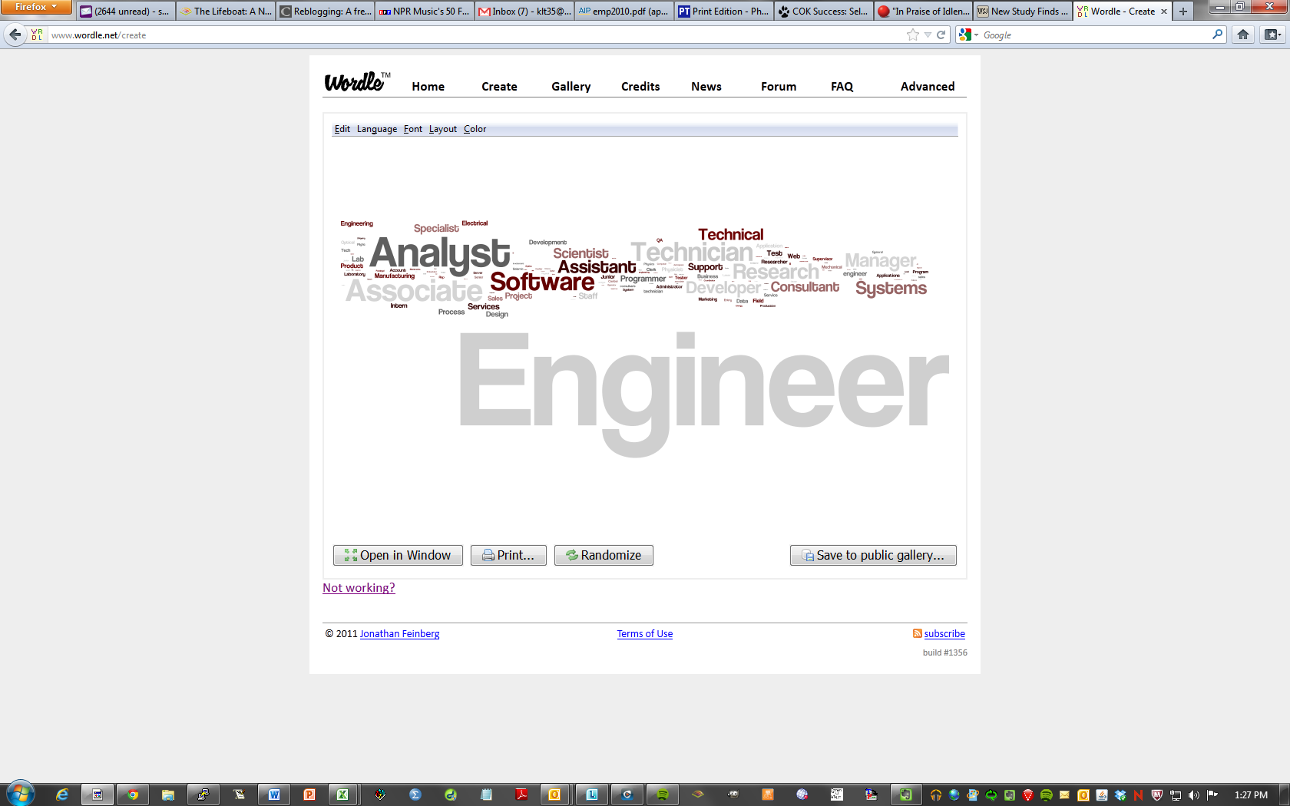
Word are Plentiful. But are they Meaningful?
1 word ≠ 1 concept

Slide 11
Language is complicated
Concepts have more than one word
Words have multiple meanings
  “That movie was sick!”
  “Our health care system is sick.”
Indirect references
  “That one is better than this.”
  “I would follow this movie to the moon and back.”
  “The one with the keyboard is more fun.”

Slide 12
Different Strategy, different controls
Precision
  % of correct hits
Recall
  % of target hit

Slide 13
Methods
Descriptive
Comparative
  Over time
  Other groupings
    Accessibility
      Link to dataset (unit of analysis problem)
      Derived from text (potentially complicated)

Slide 14
How has the No Child Left Behind Act affected the physics program or your classes at your school?
Past:
  “We have not seen much change“
  “I don’t know what changes to attribute to NCLB”
Present:
  “Not many students take physics because it's not required.”
  “Students not very enthusiastic, because it’s required”
Future:
  “not at all yet--in two years all students will be required to take physics”

Slide 15
Methods
Automated
Assisted
Manual
Varying degrees of customization

Slide 16
Tools
  Software packages or programming inhouse
    Training/ Learning curve
    Repeatability, tweakability, documentation, transparency
  Web interfaces (API’s), Service providers
    Field constantly evolving
      “Bake - off mentality”
    Hot commodity
      Proprietary knowledge, secret formulas, less transparency
      Black box

Slide 17
Analysis Potential
Wider array of data sources
  Social media
  Journals
  Interview or Focus Group transcripts

Slide 18
In Summary
Language is patterned grammatically, not topically
To fully take advantage of text data, we need to think carefully about the meaningful patterns in our data
Isolating these patterns requires a complicated balance between precision and recall
The field of text analysis is fast growing and changing and may broadly influence our field in the future

Slide 19
Further Resources
Free Range Research blog: http://www.freerangeresearch.com
King, Gary, and Will Lowe. An Automated Information Extraction Tool For International Conflict Data with Performance as Good as Human Coders: A Rare Events Evaluation Design. International Organization 57 (2003): 617-642. copy at http://j.mp/lxhNuB
NLTK: http://www.nltk.org/
Pang, Bo, and Lee, Lillian (2008). Opinion Mining and Sentiment Analysis. Foundations and Trends in Information Retrieval. Vol 2(1-2), pp. 1-135
My paper: http://www.mapor.org/2011_papers/6b5Tesfaye.pdf
  Final analysis available: http://www.aip.org/statistics

Slide 20
Some providers
Packages
  Provalis QDA miner and wordstat (http://www.provalisresearch.com/simstat/simstw.html)
  Textpack (Gesis) (manual and assisted, develop & validate dictionary)
  Language Logic Ascribe (automated (sentiment, concepts), hybrid, manual)
  nVivo
  Atlas (mostly or entirely manual coding necessary)
  Excel, word, etc. (entirely manual)
  SPSS
    Dictionary (standard or custom)
    Sentiment tagged
    Steep learning curve
API’s and Service Providers
  Crimson Hexagon (assisted)
  Open Amplify (manual)
  Radian6 (uses some Open Amplify technology)
  Vigiglobe (integrates cloud functionality)
  Revelation (proprietary SNS)
Programming Languages
  R (see: http://f.cl.ly/items/12070m0e1y1g0S3h1k1O/paper.pdf)
  Python (NLTK available)

Slide 21
To follow up with me:
Casey Langer Tesfaye
clanger@aip.org
http://www.freerangeresearch.com
Twitter: FreeRangeRsch

